Slide 1
Artificial Intelligence Methods (AE2AIM)
Lec. 05: Population Based Metaheuristics
Dr. Xinan Chen (Room IAMET 308)
School of Computer Science
The University of Nottingham Ningbo, China
Email: xinan.chen@nottingham.edu.cn

Slide 2
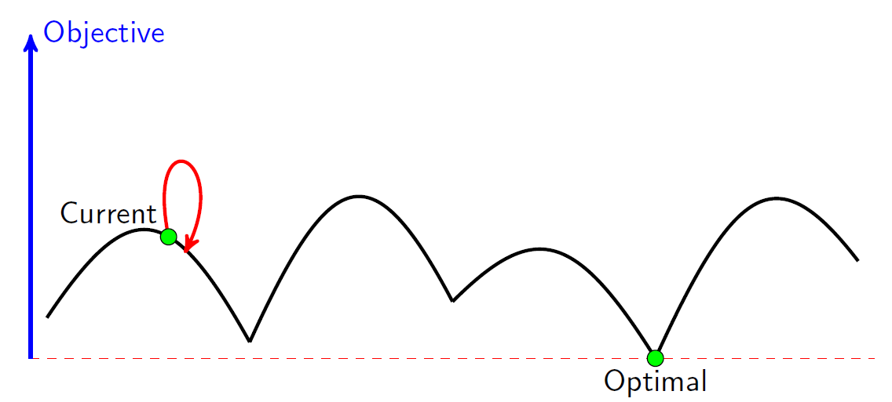
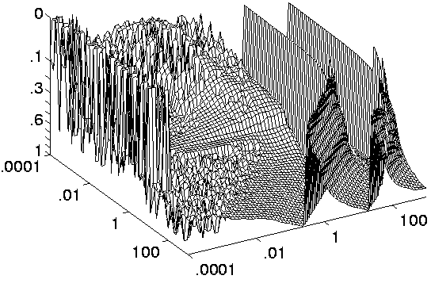
Previous lecture
Cycles!!!
p = e^{-[f (s’) – f (s)] / t}
Constructive
Greedy Heuristics
NN, FF, BF, SDF
Iterative
Simplex (Linear Programming)
Simple Local Search
Simulated Annealing
Tabu Search
VNS

Slide 3
In this lecture
Population-based metaheuristics
Evolutionary Algorithms
History
Applications
Basic components of an EA

Slide 4
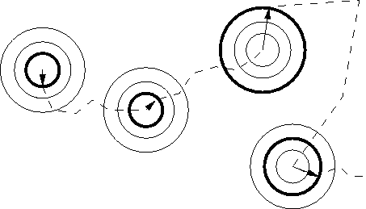
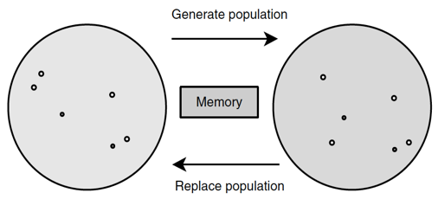
Necessity of P-metaheuristics
并行原启发式
Needs for parallel algorithms
Hardware evolution
Many natural-inspired systems are populations based
Human, ants, bees, birds, …
Survival of the fittest
Some individuals may lose the competitions but the population improves over evolution.
适者生存
Notes:
Beak 喙[huì]

Slide 5
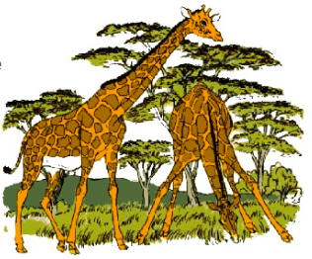
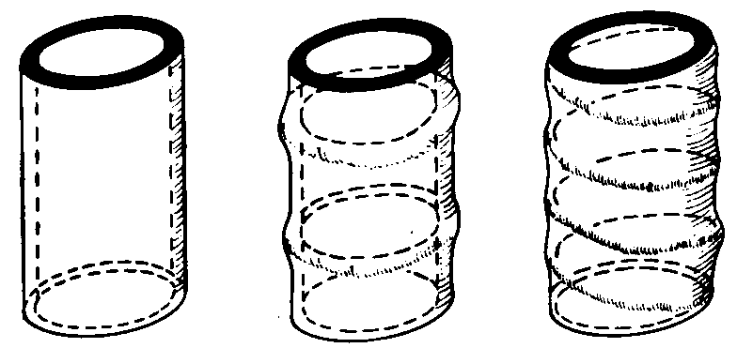
Natural Evolution
Nature as a Problem Solver: 4.55 Billion years of evolution can’t be wrong.
Beauty-of-nature argument: Complexity, robustness, efficiency achieved in short time in nature.
Can we solve complex problems as quickly and reliably on a computer?
Natural selection examples
COVID-19
Insect Trachea
Stem
Bamboo
YouTube: What is natural evolution? by Stated Clearly

Slide 6
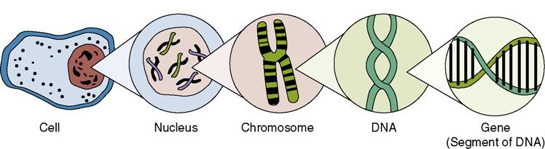
DNAs, Chromosomes, and Human
Tissues
Organs
Adapted from Stated Clearly®
Notes:
DNA is a spiralling chain-like molecule made of nucleotides. DNA nucleotides come in 4 different types: A C T and G.
A Gene is a setment of DNA that codes for something, usually a protein or a group of proteins. A typical human gene may be between 300-1m nucleotide pairs long.
Chromosome: entire chain of DNA along with a group of stablizing proteins.

Slide 7

Main Evolutionary Algorithms
Genetic Algorithm
Bit string encoding
Most widely used
Genetic Programming
Evolves computer programs in tree form
Gene Expression Programming (computer programs of different sizes are encoded in linear chromosomes of fixed length)
Grammatical Evolution (evolves solutions wrt a specified grammar) Ryan, Collins and O'Neill 1998
Evolutionary Strategy
Vectors of real numbers, mostly mutation only
Selection is based on fitness rankings, not on the actual fitness values.
Differential Evolution
Based on vector differences
Primarily suited for numerical optimization problems with objective functions that are non-continuous, non-linear and noisy and flat.
[J.H. Holland. 1975. Adaptation in Natural and Artificial Systems. University of Michigan Press]
John Holland (1929-2015)
[LJ Fogel, AJ Owens, MJ Walsh, 1966. Artificial intelligence through simulated evolution. John Wiley]
[I Rechenberg (1971): Evolutionsstrategie – Optimierung technischer Systeme nach Prinzipien der biologischen Evolution (PhD thesis).
[R Storn and K Price. (1997). "Differential evolution - a simple and efficient heuristic for global optimization over continuous spaces". Journal of Global Optimization. 11: 341–359
Notes:
Genetic algorithm – This is the most popular type of EA. One seeks the solution of a problem in the form of strings of numbers (traditionally binary, although the best representations are usually those that reflect something about the problem being solved)^{[1]}, by applying operators such as recombination and mutation (sometimes one, sometimes both). This type of EA is often used in optimization problems
Genetic programming – Here the solutions are in the form of computer programs, and their fitness is determined by their ability to solve a computational problem
Evolution strategy – Works with vectors of real numbers as representations of solutions, and typically uses self-adaptive mutation rates. The selection is based on fitness rankings, not on the actual fitness values.
Differential evolution – Based on vector differences and is therefore primarily suited for numerical optimization problems with objective functions that are non-continuous, non-linear and noisy and flat..

Slide 8
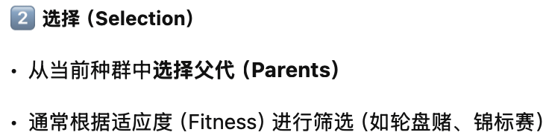
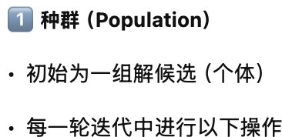
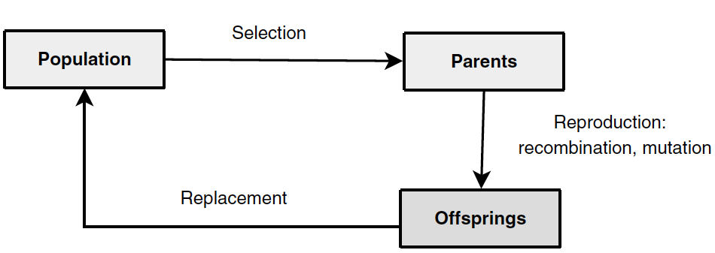
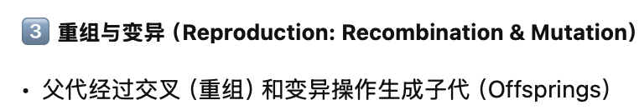

General Components of EAs
这个流程体现了“选择-遗传-更新”的核心思想，适用于遗传算法（GA）、差分进化（DE）等多个进化类算法。

Slide 9
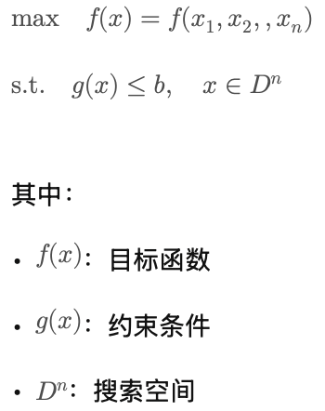
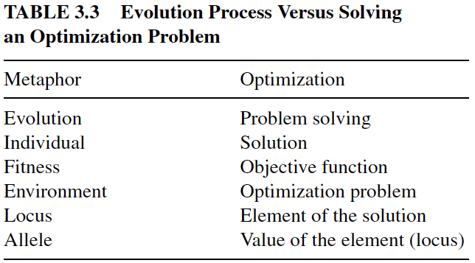

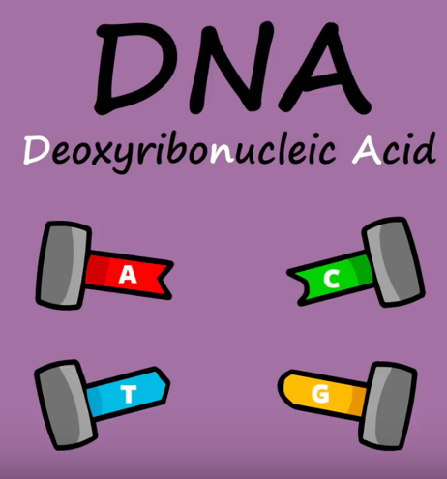
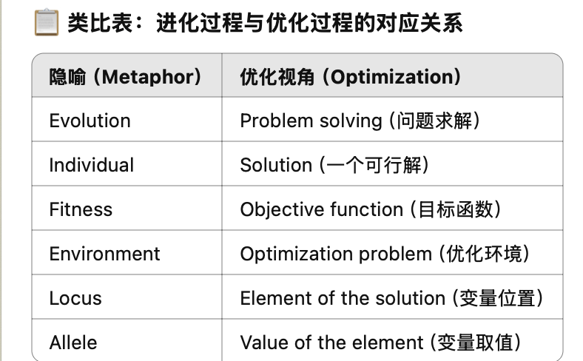
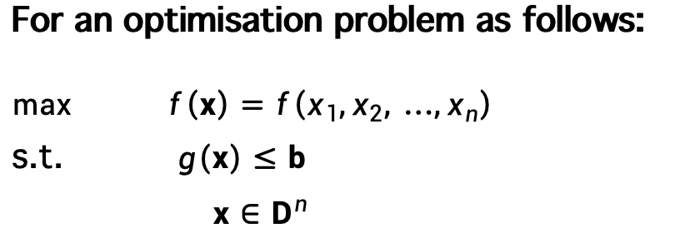
EA vs Optimisation Problem
For an optimisation problem as follows:
$$max f\left(x\right)=f\left(x_{1},x_{2}, …,x_{n}\right)$$
s.t. $g\left(x\right)≤b$
$x∈D^{n}$
Human Chromosomes
Adapted from Stated Clearly®

Slide 10
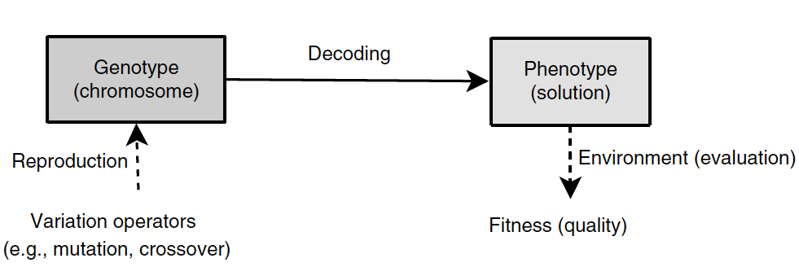
Genotype v.s. Phenotype

Slide 11
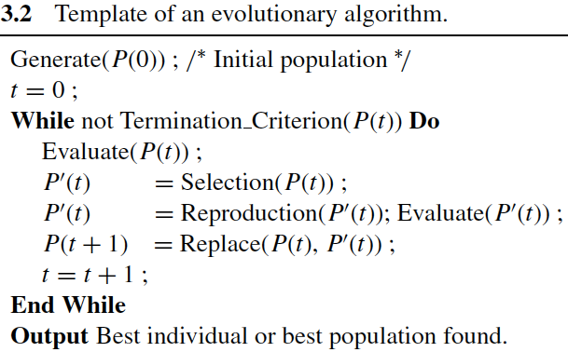
Pseudo Code of a Basic GA

Slide 12
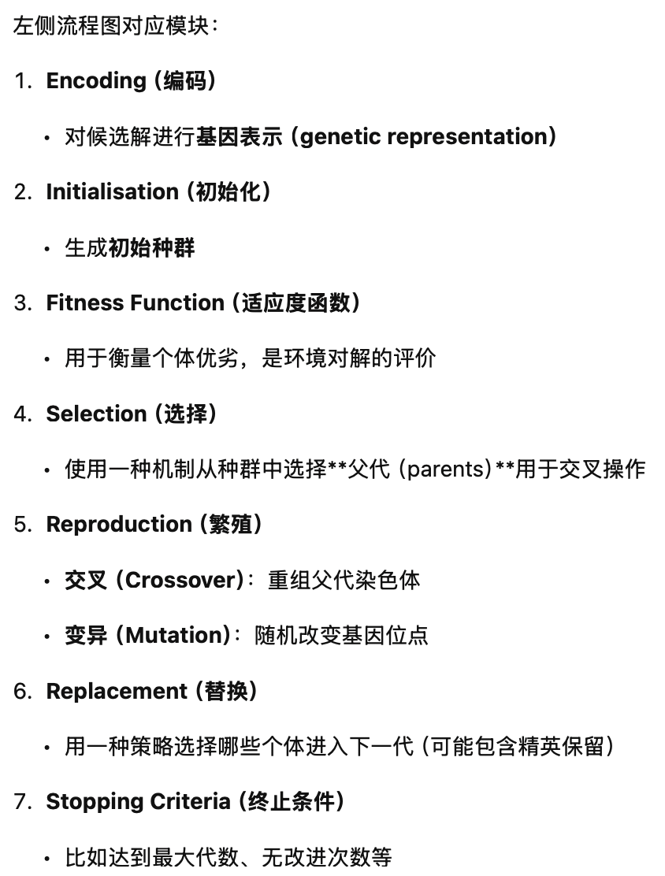
Basic Components of GAs
Encoding
A genetic representation (encoding) for candidate solutions to the problem at hand
An initialisation scheme to generate the first population of candidate solutions
A fitness function that plays the role of the environment, rating the solutions in terms of their fitness
A scheme for selecting mates (parents) for recombination
Crossover (recombination)
Mutation
Replacement strategy to select the surviving individuals for the next generation
Termination Criteria
Values for various parameters that the genetic algorithm uses (population size, probabilities of applying genetic operators, etc)
Initialisation
Selection
Reproduction
Replacement
Fitness function
Stopping Criteria

Slide 13
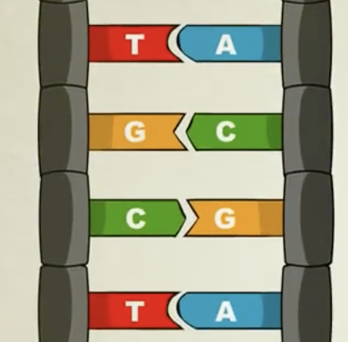
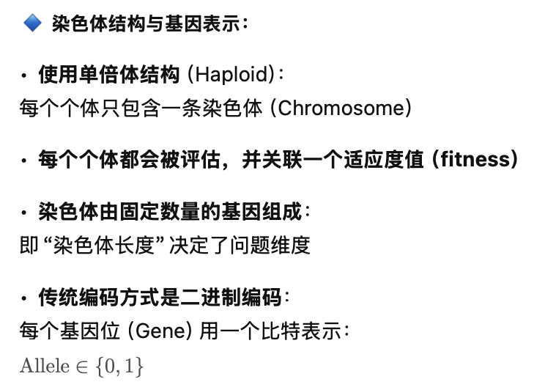
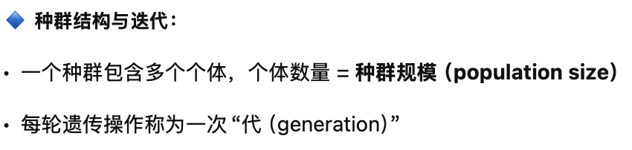
A Basic GA – Representation
Encoding
Human Chromosomes
Haploid structure is used: Each individual contains one chromosome
Each individual is evaluated and has an associated fitness value
Chromosomes contain a fixed number of genes: chromosome length
Traditionally binary encoding is used for each gene: Allele value ∈ {0,1}
A population contains a fixed number of individuals: population size
Each iteration is referred as generation
Initialisation
Selection
Reproduction
Replacement
Fitness function
Stopping Criteria
Adapted from Stated Clearly®

Slide 14
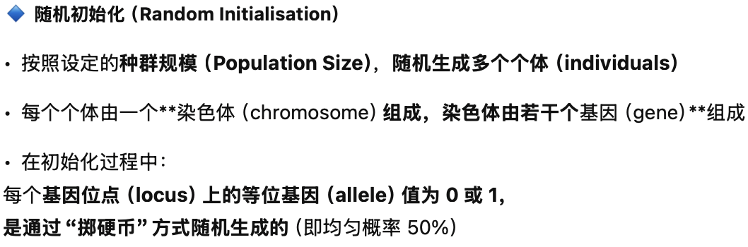
Generic GA – Initialisation
Encoding
Random Initialisation
Population size number of individuals are created randomly
Each gene at a locus of an individual is assigned an allele value 0 or 1 randomly, decided by flipping a coin.
Initialisation
Chromosome (individual)
gene
Selection
0
0
1
1
1
1
0
0
0
1
1
Reproduction
Replacement
1
2
3
4
5
locus
Fitness function
Stopping Criteria
Flip a coin

Slide 15
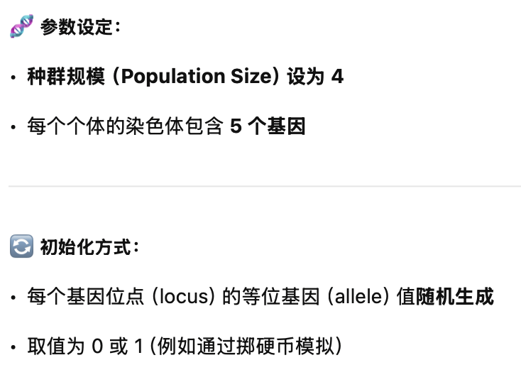
Example II
Set population size = 4
Create 4 individuals with 5 genes on their chromosomes, where each allele at a locus is determined randomly.
0
1
1
0
1
0
0
0
1
0
0
1
0
0
1
1
0
1
0
1
Initial Population
•初始化是遗传算法的起点，虽然是随机的，但应尽量多样化，避免早期陷入局部最优。

Slide 16
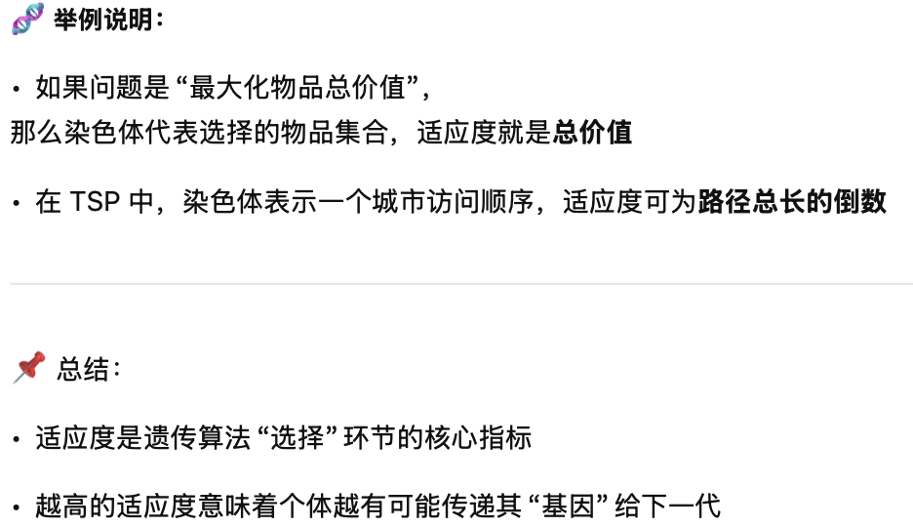
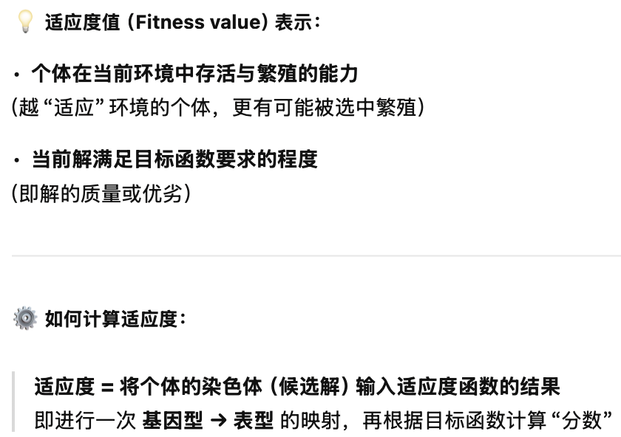
Generic GA – Fitness Calculation
Encoding
Fitness value indicates
how fit the individual is to survive and reproduce under the current conditions
how much the current solution meets the requirements of the objective function
Fitness value is obtained by applying the fitness function to the individual’s chromosome (candidate solution) – genotype to phenotype mapping
Initialisation
Selection
Reproduction
Replacement
Fitness function
Stopping Criteria

Slide 17
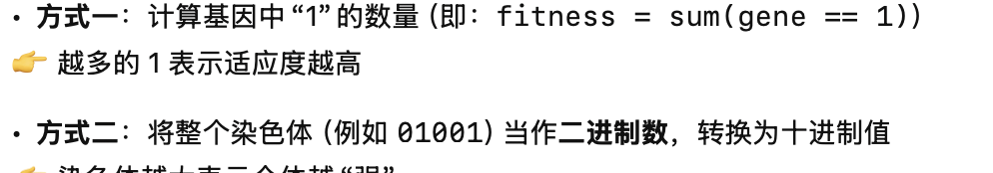
Example III
Fitness function = the number of genes that are 1s
Fitness function = convert the binary number into decimal
3
13
0
1
1
0
1
二进制转化成十进制：01101->13
1
2
0
0
0
1
0
2
9
0
1
0
0
1
3
21
1
0
1
0
1
Initial Population

Slide 18
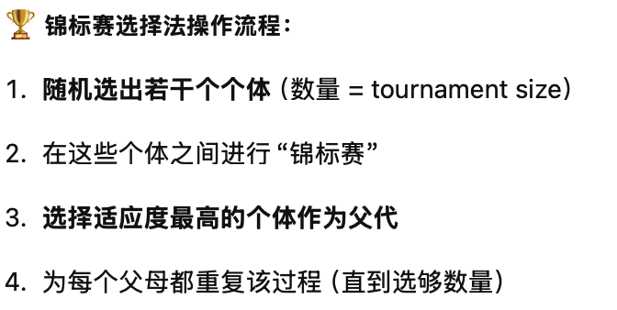
Selection: Tournament Selection
Encoding
Selection strategy decides which individuals have chance to reproduce. Common methods include roulette wheel selection, tournament selection, rank selection, truncation selection, Boltzmann selection, etc.
Tournament selection method involves running a number of "tournaments" among randomly chosen individuals (of tourm. size) selecting the one with best fitness at the end
This process is repeated for selecting each parent to be recombined
Initialisation
Selection
•轮盘赌选择；锦标赛选择；排名选择；截断选择；Boltzmann 选择
Reproduction
Replacement
Fitness function
Stopping Criteria

Slide 19
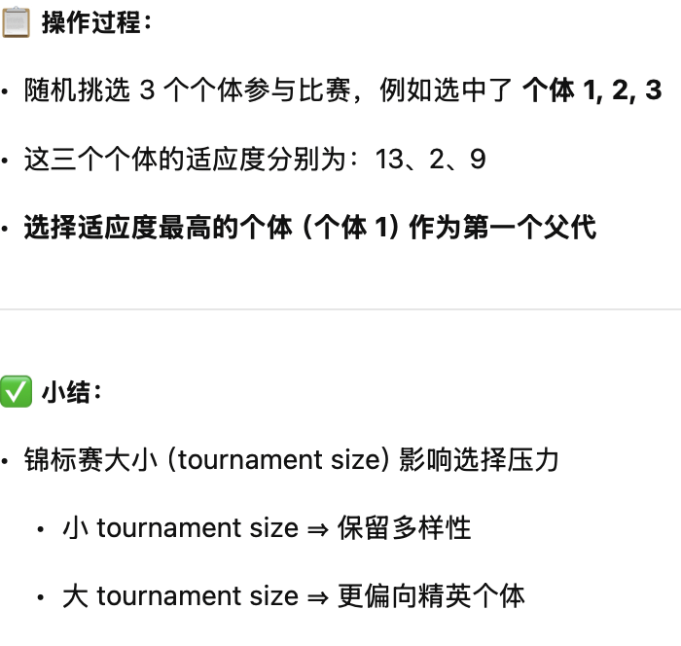
Example – tourm. size = 3, first parent
Assume the method chooses randomly chosen individual#1, #2 and #3 at random, then individual#1 with the fitness of 13 is returned as the first parent
0
1
1
0
1
13
0
0
0
1
0
2
0
1
0
0
1
9
1
0
1
0
1
21
Population
如果继续选择第二个父代，可以再进行一次新的锦标赛，避免重复选择。

Slide 20
Example – tourm size = 3, second parent
Assume the method chooses randomly chosen individual#1, #3 and #4 at random, then individual#4 with the fitness of 21 is returned as the second parent
0
1
1
0
1
13
0
0
0
1
0
2
0
1
0
0
1
9
1
0
1
0
1
21
Population
同上

Slide 21
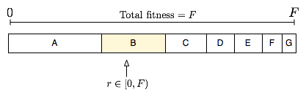
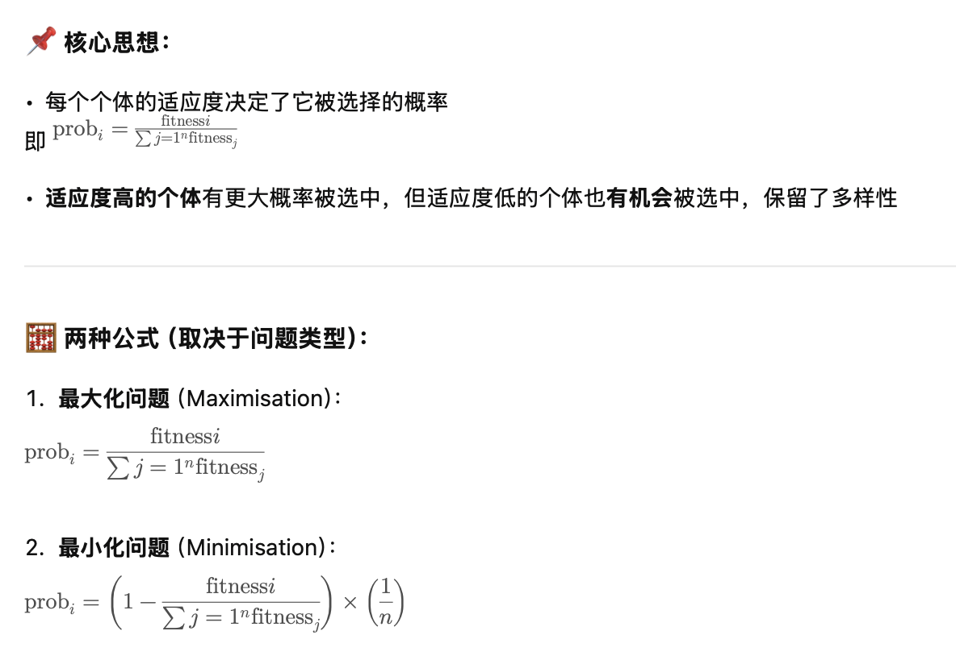
Fitness Proportionate Selection – Roulette Wheel Selection
Fitness level is used to associate a probability (prob_{i}) of selection with each individual chromosome (i)
While candidate solutions with a higher fitness will be less likely to be eliminated, there is still a chance that they may be
Expected number of representatives of each individual in the pool is proportional to its fitness
Maximisation problem
3
4
2
1
minimisation problem
pop.size

Slide 22
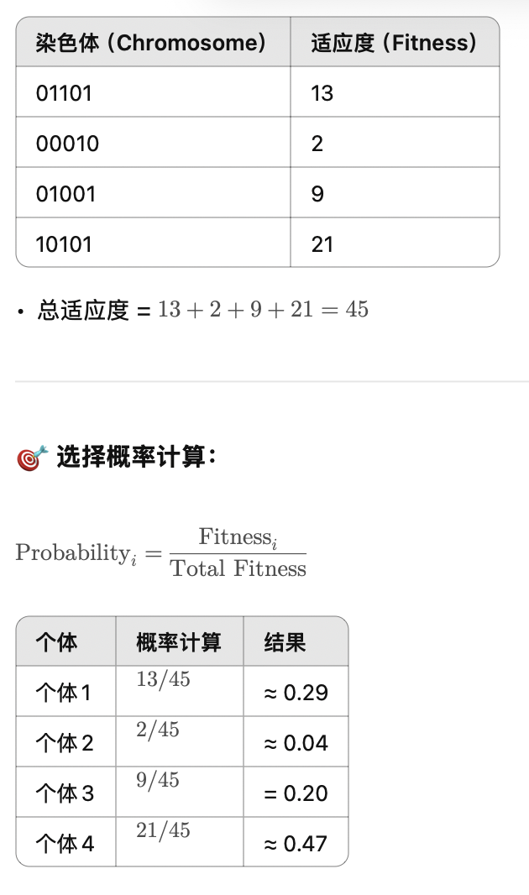
Example IV
使用这些概率构建“轮盘”，通过生成随机数选择父代。适应度越高，被选中的概率越大，但不是绝对（有“随机性”保留了多样性）。
Probability of each individual being selected:
0
1
1
0
1
13
13/45=0.29
0
0
0
1
0
2
2/45=0.04
0
1
0
0
1
9
9/45=0.2
1
0
1
0
1
21
21/45=0.47
Total Fitness: 45
Population

Slide 23
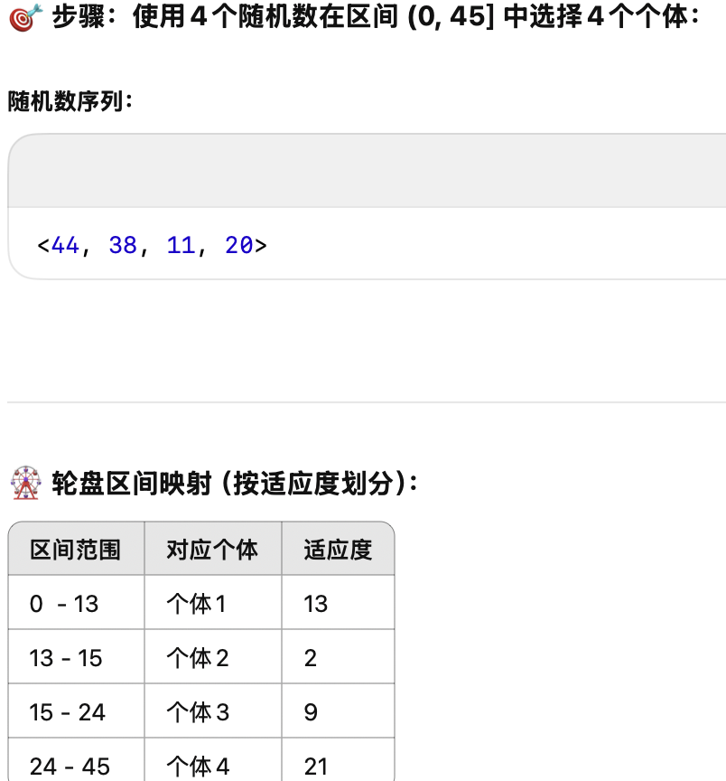
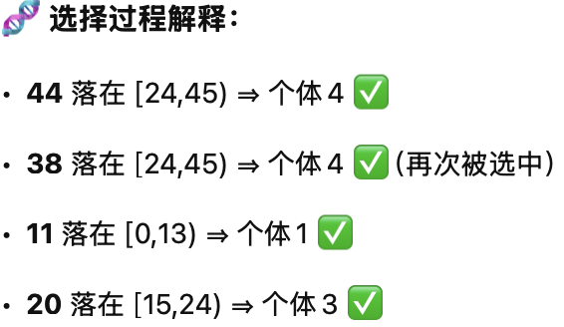
Example – Forming the Mating Pool
4 random numbers are thrown in (0,45] to select 4 mates
Assuming a random number sequence of <44, 38, 11, 20> , two copies of fourth, one copy of third and first individuals are created for crossover
这个过程体现了适应度越高，被选中的可能性越大的原则。
0 13 15 24 45

Slide 24
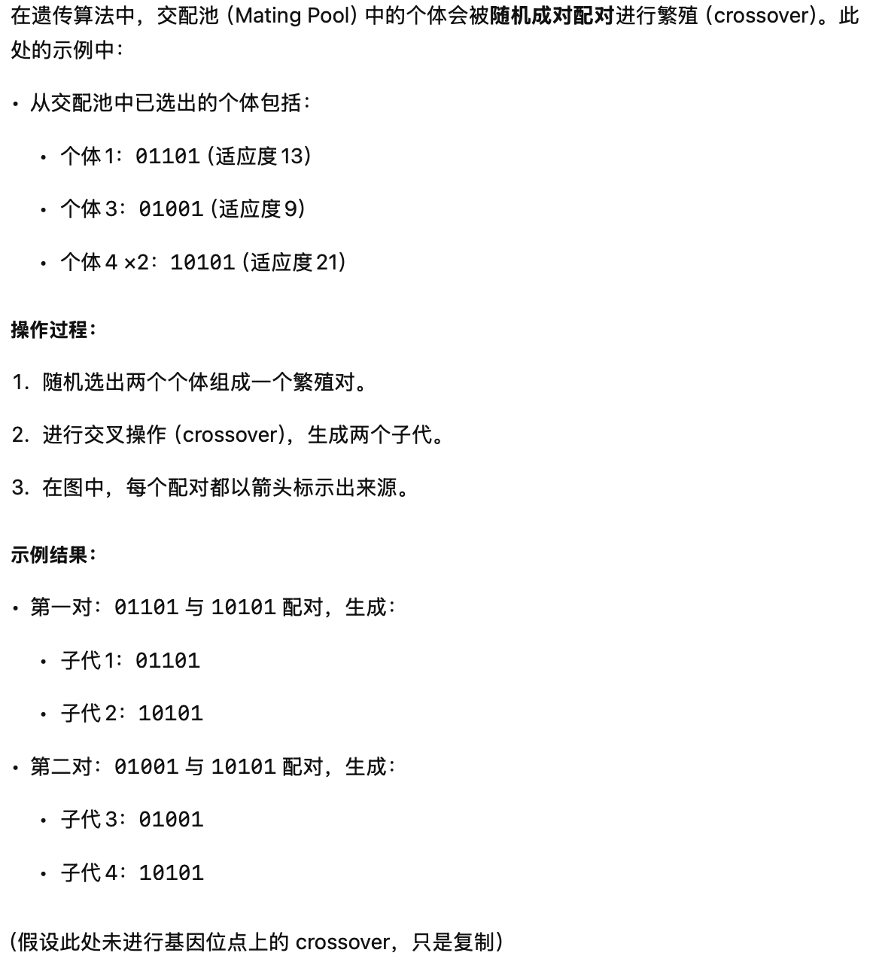
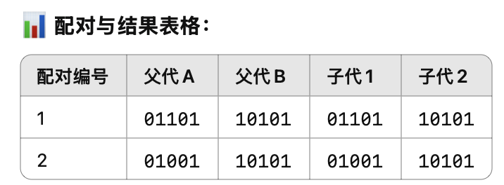
Example V
Assume 2 pairs of individuals are mated, randomly for reproduction
0
1
1
0
1
13
0
1
0
0
1
9
0
1
1
0
1
1
0
1
0
1
21
1
0
1
0
1
1
0
1
0
1
21
0
1
0
0
1
Mating Pool
1
0
1
0
1

Slide 25
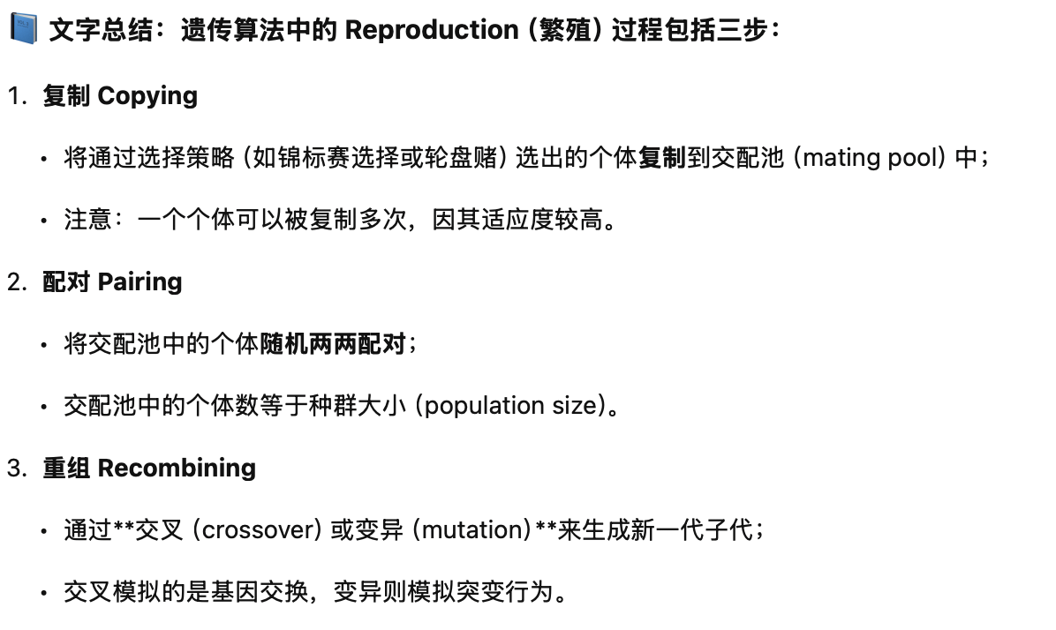
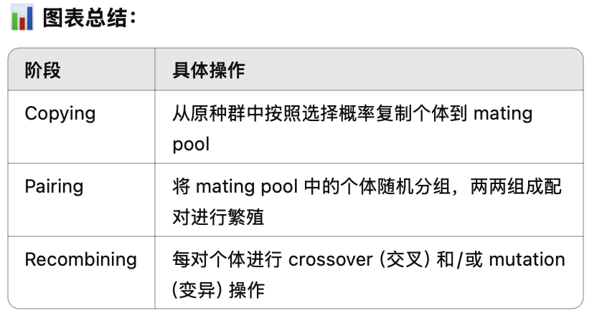
Generic GA – Reproduction
Encoding
Reproduction consists of
copying selected individuals into a mating pool (each individual may be selected more than once)
pairing individuals in pool for mating: mating pool consists of population size number of elements
recombining: crossover/mutation
Initialisation
Selection
Reproduction
Replacement
Fitness function
Stopping Criteria

Slide 26
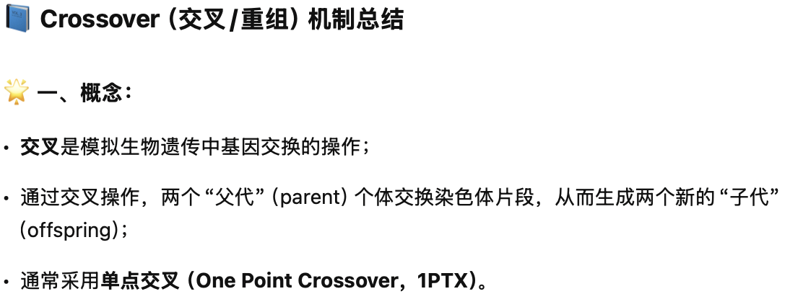
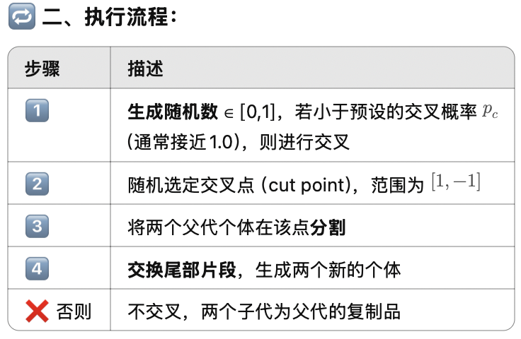
Recombination/Crossover
Encoding
Selected pairs/mates (parents) are recombined to form new individuals (children/offspring) – exchange of genetic material
Crossover is applied with a crossover probability p_{c} which in general is chosen close to 1.0
One Point Crossover (1PTX)
Generate a random number in [0,1), if it is smaller than a crossover probability p_{c} Then
Select a random crossover site in [1,choromosome length]
Split individuals at the selected site
Exchange segments between pairs to form two new individuals
Else
Copy the individuals as new individuals
Initialisation
Selection
Reproduction
Replacement
Fitness function
Stopping Criteria

Slide 27
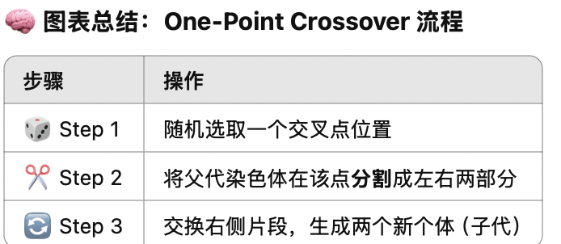
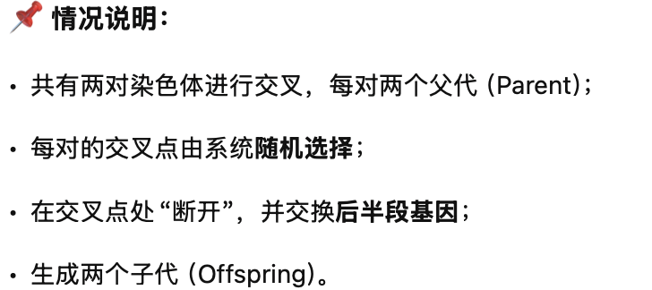
Example VI
Randomly determined crossover points
0
0
1
0
1
0
1
1
0
1
1
1
1
0
1
Exchange genetic material
1
0
1
0
1
1
0
1
0
1
1
0
1
0
1
0
1
0
0
1
0
1
0
0
1
Offspring

Slide 28
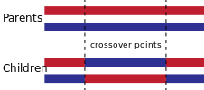
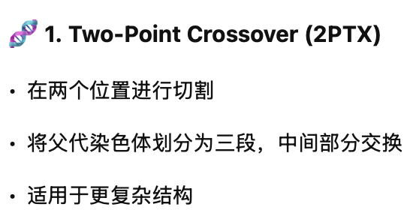
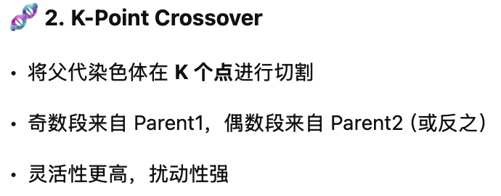
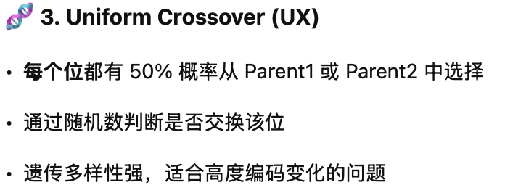
Other Crossover Operators
2 Point Crossover (2PTX)
K-point Crossover
Uniform Crossover (UX)
The uniform crossover considers each bit in the parent strings for exchange with a probability of 0.5.
0
0
1
0
1
0
1
1
0
0
Random Number
0.23 0.76 0.15 0.34 0.91
1
1
1
0
0
1
0
1
0
1

Slide 29
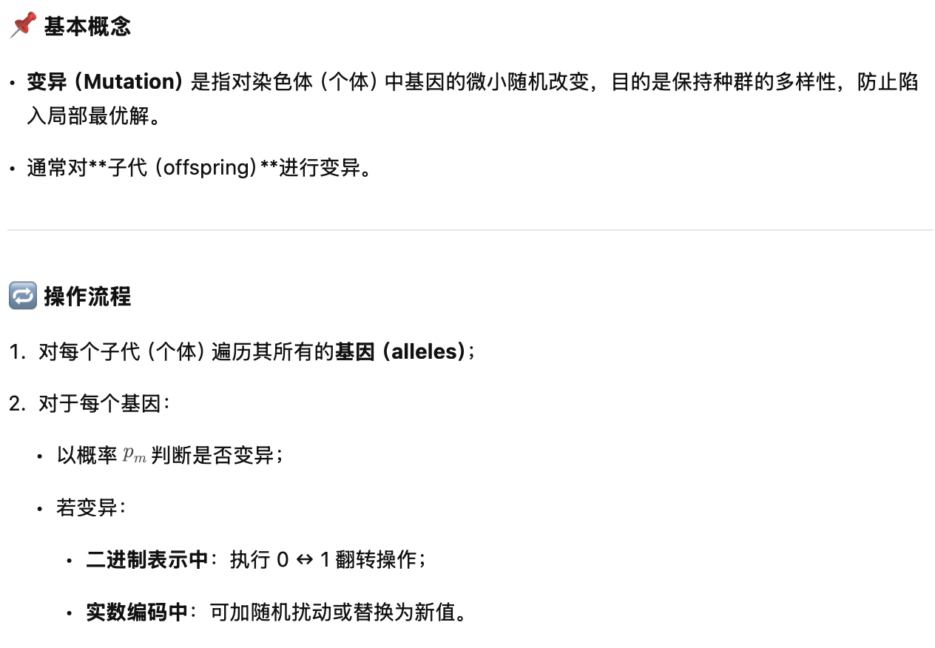
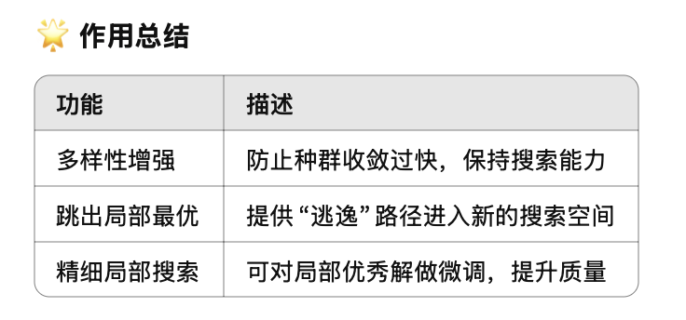
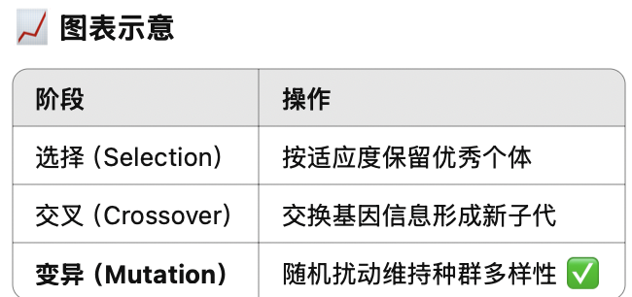
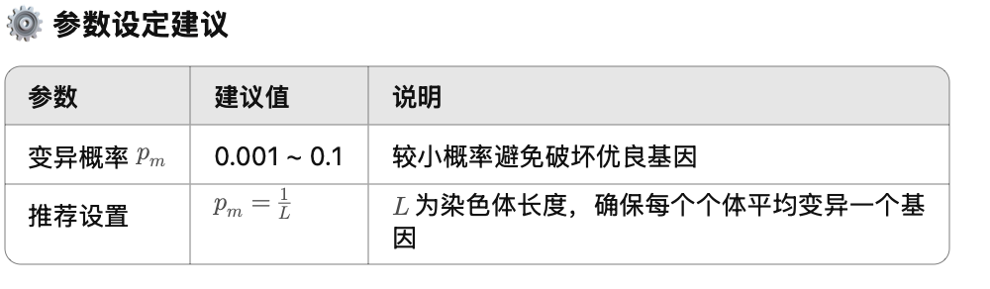
Mutation
Any offspring might be exposed to mutation
Loop through all the alleles of all the individuals one by one, and if that allele is selected for mutation with a given probability p_{m}, you can either change it by a small amount or replace it with a new value
For binary representation mutation corresponds to flipping a selected gene value (0→1, 1→0)
Mutation provides diversity and allows GA to investigate different regions of the search space (escaping)
Mutation rate is typically chosen to be very small (0.001, 0.1). Choosing p_{m} as (1/chromosome length) implies on average a single gene will be mutated for an individual.

Slide 30





Example VII
A loop is performed on each individual
If a random value in [0,1) is < p_{m} =0.2 (1/5), then the allele value is flipped, otherwise kept same.
0.23 0.76 0.41 0.14 0.91
1
1
1
1
0
1
0.47 0.19 0.28 0.94 0.78
0
0
1
0
0
1

Slide 31




Replacement Strategy
Encoding
There are variety of strategies for replacing the old population by the new offspring population to form the next generation
Generation gap (g): the fraction of new individuals at each generation.
(Trans-)Generational GA
N individuals produce N (or αN) offspring (largest gap, i.e. g=N). N+ αN→N: e.g., αN replace worst αN of N, sort (N+ αN) and choose N best (elitism)
Steady-State GA
Two offspring replace two individuals from the old generation (g=2): e.g. two offspring replace parents, or worst two of the population (elitism), or best two of parents and offspring replace parents or worst two of the population (elitism)
Initialisation
Selection
Reproduction
Replacement
Fitness function
Stopping Criteria

Slide 32


Example VIIIa
Start the new generation by
0
1
1
0
1
13
copying offspring onto the old population, forming the new population
0
0
1
0
1
5
0
0
0
1
0
2
1
1
1
1
1
31
0
1
0
0
1
9
1
0
1
0
1
21
1
0
1
0
1
21
0
0
0
0
1
1
Old Population
Offspring

Slide 33



Example VIIIb
精英选择 (Elitist Selection)，即从旧种群 + 后代中选择最优秀的个体进入下一代
Start the new generation by
0
1
0
0
1
13
Selecting the best 4 individuals among both old population and offspring
1
1
1
1
1
31
0
1
0
0
1
9
1
0
1
0
1
21
New Population

Slide 34


Termination Criteria
Encoding
The evolution (main loop) continues until a termination criteria is met, possibly until:
A predefined maximum number of generations is exceeded
A goal is reached, for example:
Expected fitness is achieved
Population converges
Best fitness does not change for a while
A condition is satisfied depending on a combination of above
Initialisation
Selection
Reproduction
Replacement
Fitness function
Stopping Criteria

Slide 35


Convergence
Defined as the progression towards uniformity (individuals become alike)
Gene convergence: a location on a chromosome is converged when 95% of the individuals have the same gene value for that location
Population (Genotypic) convergence: a population is converged when all the genes have converged
Phenotypic Convergence: average fitness of the population approaches to the best individual in the population

Slide 36



Simple GA Algorithm - Summary
Encoding
Randomly generate a population of candidate solutions to the problem at hand (initial generation)
Evaluate how fit each solution is
Copy the best solution into the best individual so far (chromosome)
Generate offspring (solution) pool
Select mates for reproduction from the current population
Apply crossover on the mates with a probability of p_{c}, producing offspring
Apply mutation on the offspring with a probability of p_{m}
Evaluate how fit each offspring (solution) is
Replace offspring with the current generation
Go to Step 3. until termination criteria are satisfied
Return the best individual (solution)
Initialisation
Selection
Reproduction
Replacement
Fitness function
Stopping Criteria

Slide 37
The next lecture
More Population based metaheuristics
GA Parameters and Extensions
Ant Colony Optimisation (ACO)

